Slide 1

P.I.E. - Pixel Image Editor
Sprint Three Overview

Slide 2
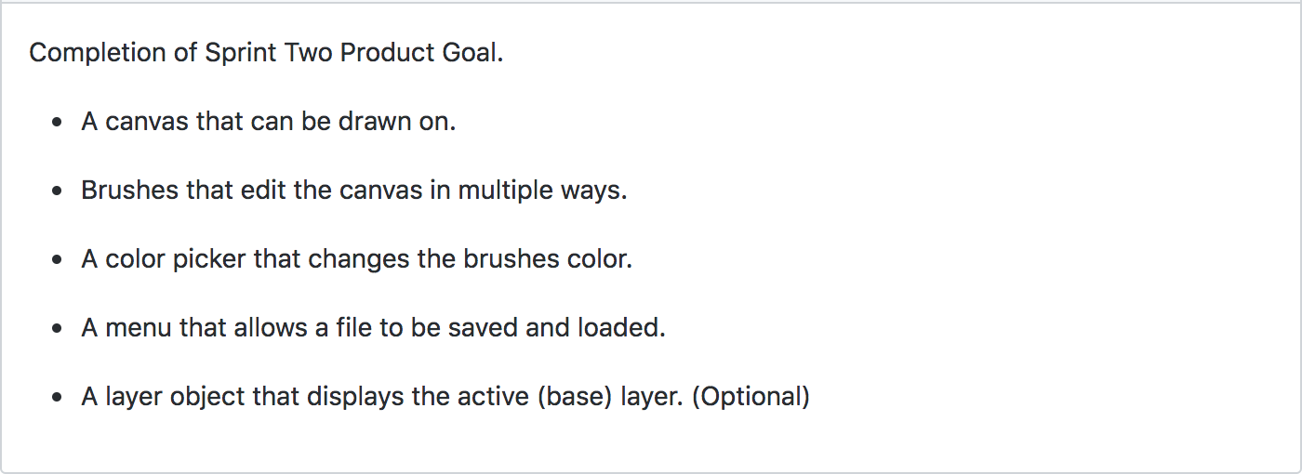
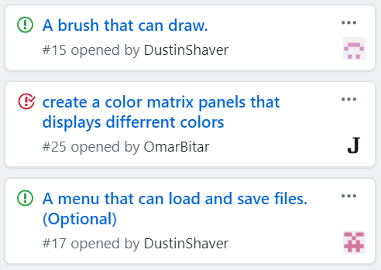
The Plan
Two goals for this sprint, one optional:
Original Sp3 tasks from GitHub

Slide 3
Specific Accomplishments
Drawing Ability
The brush edits the canvas ✔
The brush can draw single pixels ✔
The brush can draw lines ✔
Screen resize ✔
Color Panel Display
The color panel now includes space for custom colors ✔
The buttons on the color panel change the brush color ✔

Slide 4
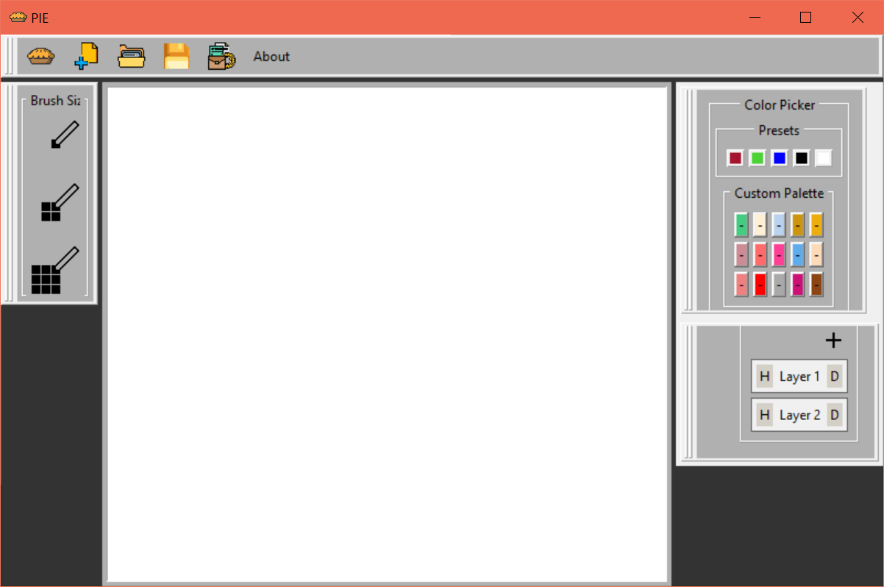
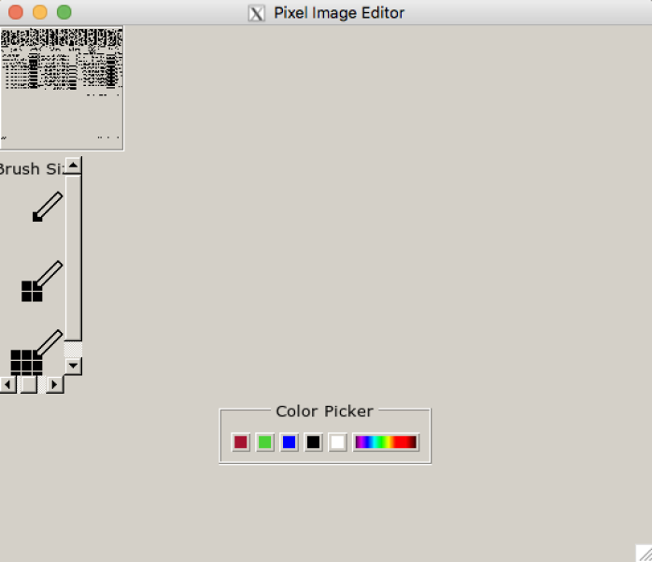
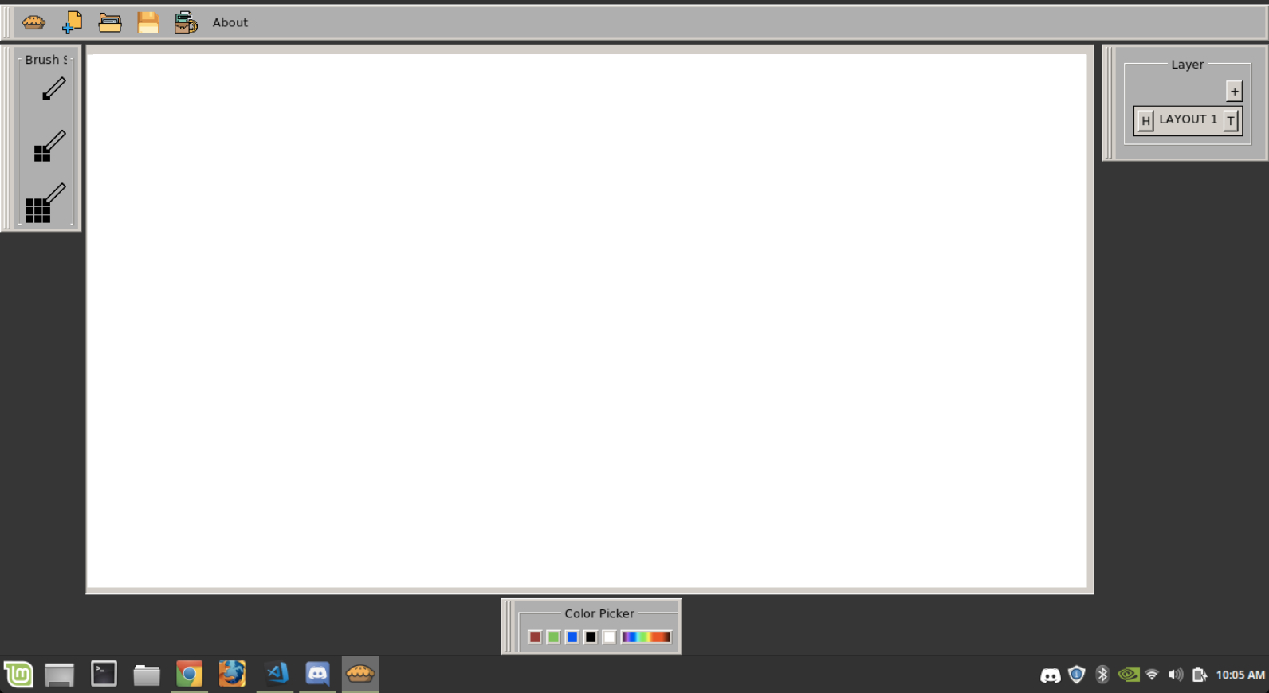
Versions
Sp1
Sp3
Sp2

Slide 5
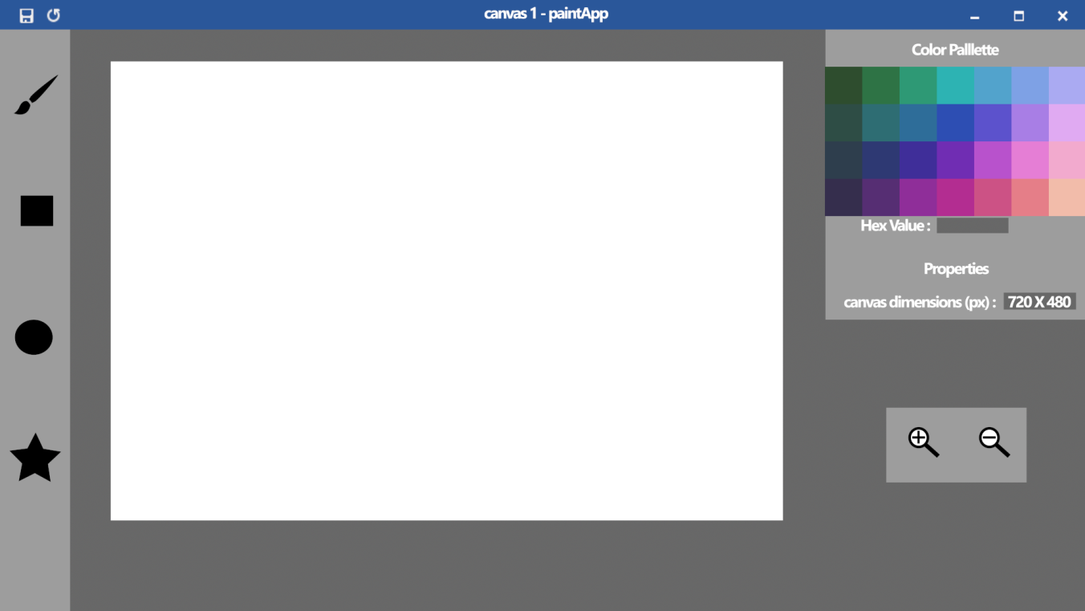
Concept V.S. Actual
Concept Art
Sprint 3

Slide 6
Hours Worked
Dustin Shaver 12 hours
Francesco Limoni 10 hours
Jacob Watters 8 hours
Nick Miller 10 hours
Omar Bitar 7 hours

Slide 7
Sprint Retrospective
What went well
Completed the two biggest tasks that were blocking us from moving forward
Went quickly
What went poorly
Snow interference
Unbalanced amount of work
Looking Ahead
Change brush sizes
Layer Panel
Toolbar Functionality

Slide 8
DEMO

